Slide 1


Storm Damaged Tree Cleanup
E.M. Bauske, P. Kelley, W. Williams and
A. Martinez-Espinoza
This material was produced under grant number SH-05052-SH8 from the Occupational Safety and Health Administration, U.S. Department of Labor. It does not necessarily reflect the views or policies of the U.S. Department of Labor, nor does mention of trade names, commercial products, or organizations imply endorsement by the U.S. Government.
Notes:
Storm Damaged Tree Cleanup
E.M Bauske, P. Kelley, W. Williams and A. Martinez-Espinoza
#1 Title
Read the disclaimer.
Unfortunately, trees are often damaged in storms and these trees can be extremely dangerous to clean up. Storm damaged trees are subject to all the perils associated with tree felling and much, much more. Working conditions may be difficult. Downed trees may be entangled in other trees, or tossed on buildings, vehicles, or wires. Energy, stored in compressed limbs and trunks can be release suddenly, explosively, and fatally. Each situation is unique and requires consideration. This is a task best left to people with considerable experience and should never be attempted by the occasional chainsaw user.

Slide 2
Before Starting
Put on Personal Protective Equipment (PPE)
Inspect the chainsaw safety features
Notes:
# 2 Before Starting
Before starting, put on Personal Protective Equipment (PPE). This includes a hard hat, eye protection, ear protection, chaps or saw pants, and appropriate boots. A chainsaw should never, under any circumstance, be operated without them. The importance of PPE can never be overstated.
Make sure the chainsaw has the five essential safety features and that they are all functional; This includes the chain brake, throttle interlock, right-hand guard, chain catch, and spark arrestor, If any of these features is broken or missing, do not use the saw.

Slide 3
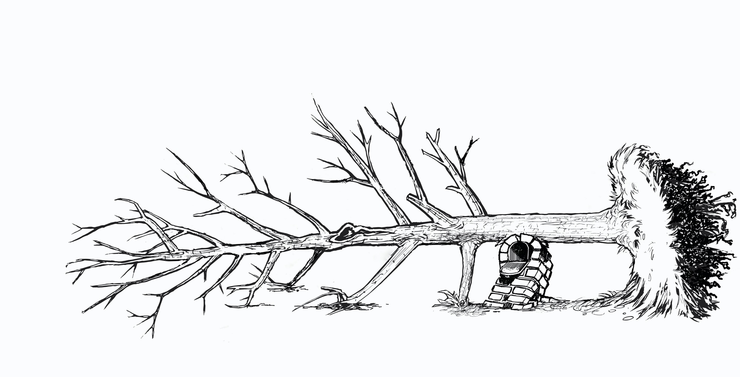
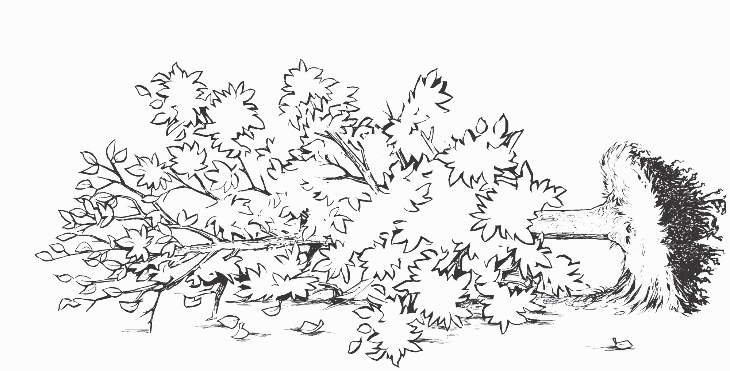
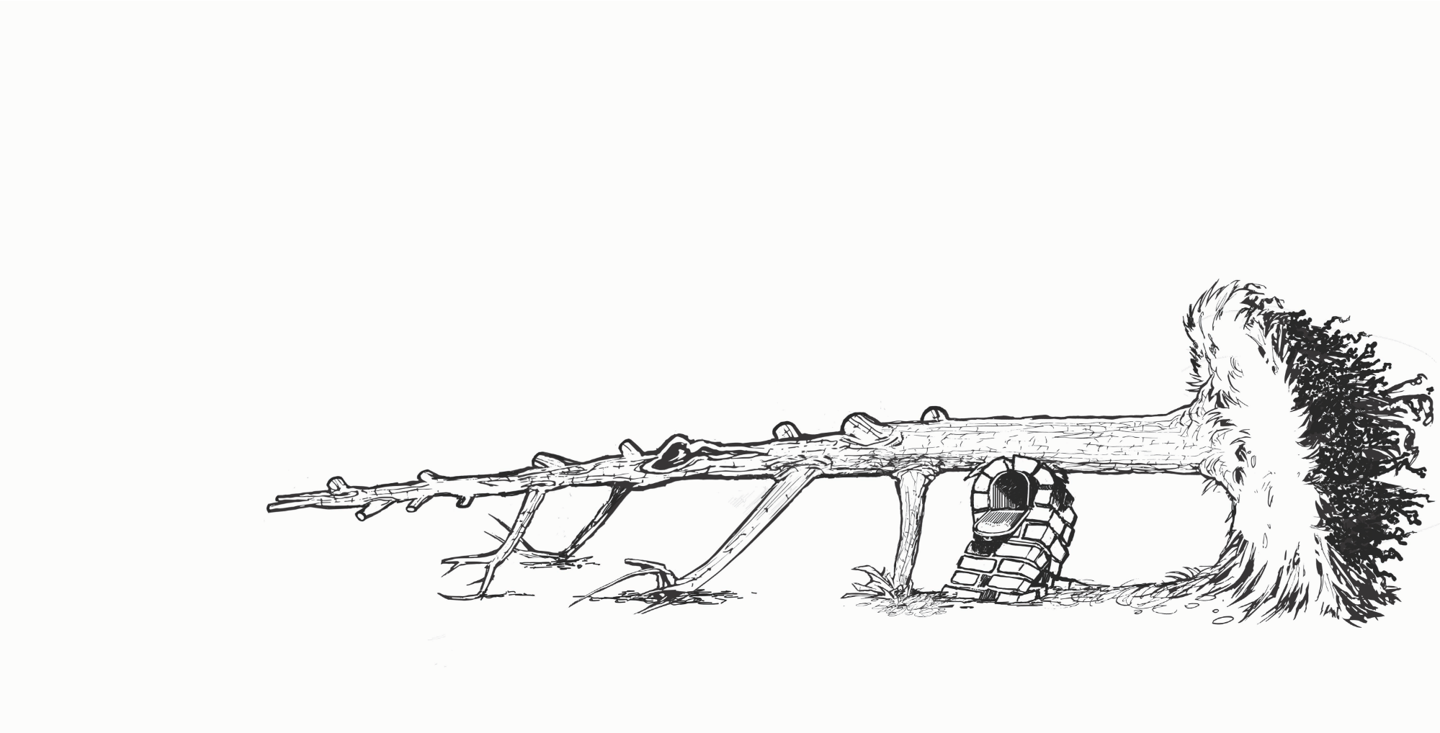
Storm Damaged Tree
Notes:
#3 Storm Damaged Tree
Now that the operator has dressed for work and inspected the saw, it is time to tackle the tree. The general approach is straightforward. Clear off the foliage and remove tripping hazards
Click to the next picture.
If possible, work from the top of the tree down. Take the weight off the tree and remove non-load-bearing branches first.
Click to the next picture.
Then systematically whittle the project down, tackling the easiest pressure point first. It sounds simple, but it can be deadly.

Slide 4

Storm Damaged Tree Cleanup
Five Step Cutting Plan for Storm Damaged Trees
  Hazards and Work/Drop Zones (electricity)
  Lean and Load (stored energy)
  Check Equipment
  Cut Plan/Escape Plan (three handy cuts, shifting escape routes, and distance release)
  Implementation of the plan (and then repeat the steps again)
Notes:
#4 Five Step Cutting Plan
Application of this Five Step Cutting Plan will help keep the saw operator safe and working effectively. First hazards must be identified as well as the work and drop zones.
The second step is very important. Storms create lean and load on trees which must be identified. Lean and load will affect how the tree moves and falls. It will also affect which cuts can be safely used.
The operator must check the equipment needed and assure that it is available and in working order.
The cut plan and escape plan are created based on the information assessed in the first three steps.
Finally, the cut plan is implemented, and the escape made.

Slide 5
Five Step Cutting Plan for Storm Damaged Tree Cleanup
1. Hazards and Work/Drop Zones
2. Lean and Load
3. Check Equipment
4. Cut Plan /Escape Plan
5. Implement Plan
Repeat Steps
Notes:
#5. Repeat plan
This plan is similar to a standard tree felling plan with one key difference. It must be repeated with each cut. With each cut, the lean and load of the tree can shift, new hazards may become important and the drop and work zones may change. The equipment needed may change. This creates the need for a new cut plan and escape plan. With each cut, the situation changes and the plan must be reworked.

Slide 6
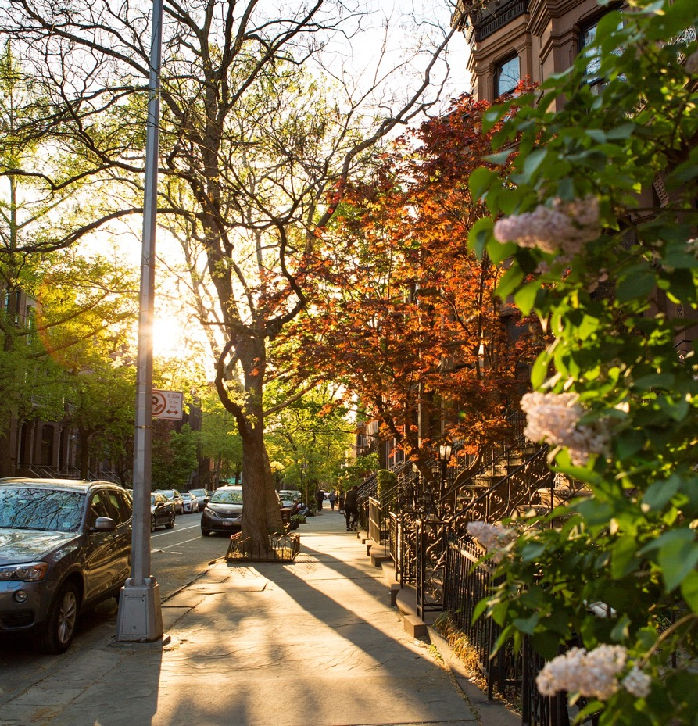
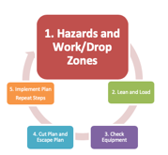
Step 1. Identify:
Hazards
Work Zone
Drop Zone
Notes:
#6 Step 1
The first step of the plan is to identify the hazards, the work zone and the drop zone. Take the time needed to very carefully inspect the tree and site.

Slide 7
Hazards
Tree
  Widow makers, decay, leaners, wildlife
Environment
  Structures, powerlines, vehicles, people, pets
Storm
  Weather, hung up and tangled trees, stored energy, wood under pressure, crushed structures
Notes:
#7 Hazards
There are Hazards associated with the tree, the environment, and the storm.
Ask participants what these hazards might be. Discussion could include leaners, snags, spring poles, hangers, widow makers, wildlife, power lines, decay, people, structures, vehicles, etc.

Slide 8
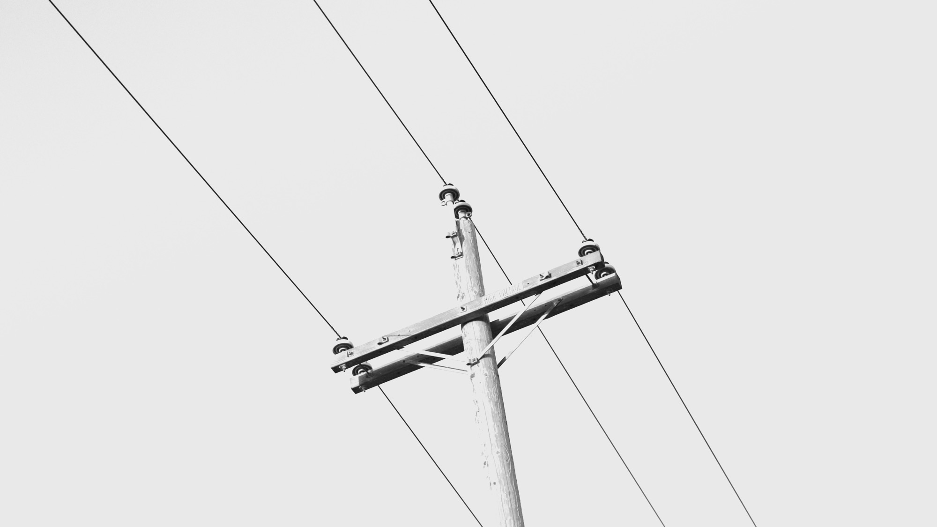
Electricity
Notes:
#8 Electricity
Any time a tree is near a wire you should be wary. There may be no indication that the tree is ”hot.”
Photo by Jeremy Perkins on Unsplash

Slide 9
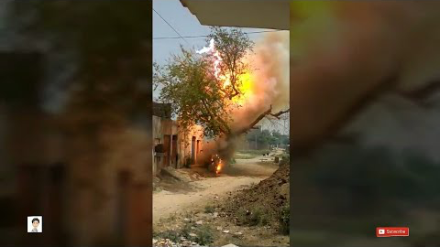
Notes:
#9 Electricity
Show the video.
https://www.youtube.com/watch?v=fxSFTAPXn9k

Slide 10
Electricity
Before You Cut Anything!!!
Make a thorough inspection
“Line clearance shall not be performed during adverse weather conditions, such as thunderstorms, high winds, and snow and ice storm.” (ANZI Z133)
Fences, gutters, anything conductive can be ”hot”
Treat all downed lines as energized
Notes:
#10 Electricity
Tree work hazards increase significantly during or after a storm. Many of the tools that we rely on to help protect us from electrical hazards such as pole pruners, saws, and aerial lifts lose their capacity to insulate when wet. The trees we work in are also much more conductive when they are wet. Strong winds can push treetops into contact with conductors and make controlling cut limbs and tops extremely difficult even with rigging. Tree workers must exercise extreme caution and judgment in these situations and, when warranted, delay the work until the weather improves.
Make a thorough inspection before approaching the tree. Line clearance is pruning, trimming, repairing, maintaining, removing, or clearing of trees or the cutting of brush that is near (within 10 feet of) energized power lines.
Since even a streetlamp circuit or phone line can be energized with enough voltage to kill, almost all arborists in the field have at least some exposure to this hazard. In fact, workers don’t even have to touch a wire to be electrocuted – about half of all electrocution fatalities are the result of indirect contact.
Even the ground under the feet can even conduct electricity, given the right soil conditions and voltage.
Treat all downed lines as energized.

Slide 11
Do Not approach or touch any downed line (power, communication, cable, or otherwise) until the utility company has cleared it as de-energized or dead.
Notes:
#11 Electricity Warning
Read the slide. Restate the slide.
Keep in mind that electricity from a downed line away from you may reach the worksite through other conductors such as chain link fences, metal curbing, or even “harmless” phone or cable lines.

Slide 12
Generator Feedback
Notes:
#12 Generator Danger
In addition, homeowners using incorrectly set-up generators can cause “back feed” into their house drop, which in turn is “pumped up” in volume by transformers, reenergizing lines the tree crew may have “known” to be dead.
If a generator is operating or the lights are on at one residence in an otherwise blacked out area, consider all conductors to be energized.
Once again, do not begin working until the utility company has cleared all downed lines as dead.

Slide 13
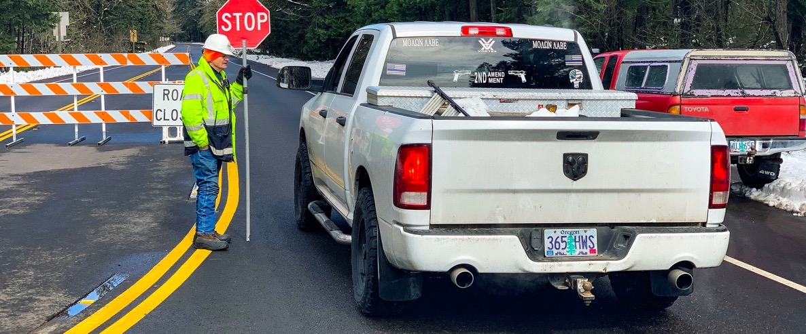
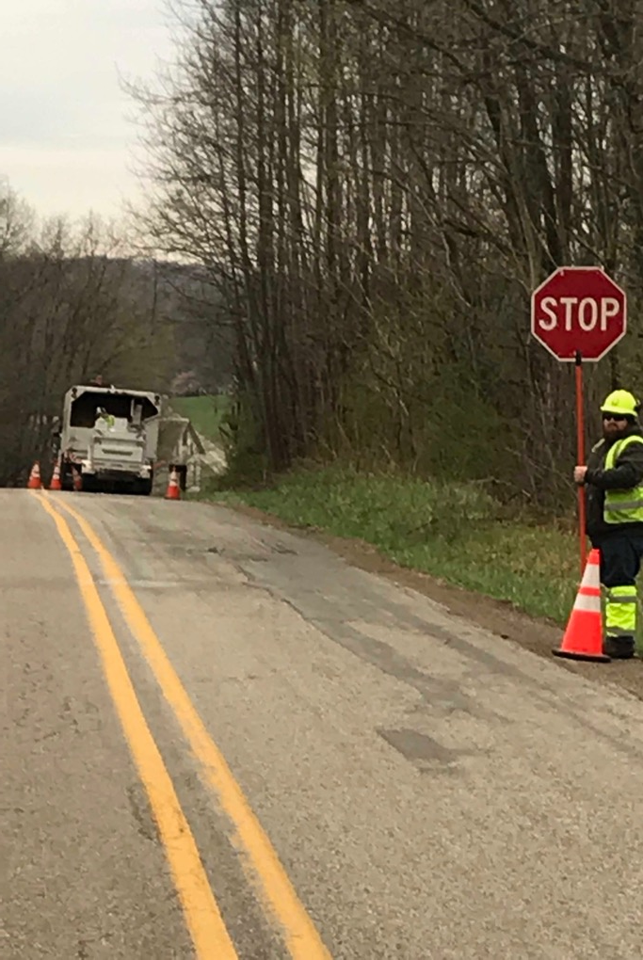
Traffic
Notes:
#13 Traffic
All workers within the right-of-way who are exposed either to traffic or to work vehicles must wear high-visibility safety apparel.
Have a plan for traffic flow and designate who is in charge of executing that plan and overseeing it. Use cones.
Pedestrians should have a path separate from vehicular traffic.
Photo credit: Oregon Department of Transportation
Phillip Kelley
#14 Work/Drop Zone

Slide 14
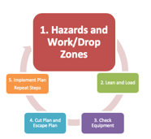

Work/Drop Zone
Establish work zone: Include any areas that are hazardous to workers or the public
Establish drop zone: Area where anything cut from the tree will fall
Notes:
#14 Work/Drop Zone
The work zone is at least two lengths of the tree being felled. On a downed tree it is determined by the highest point of the tree.
The drop zone is the area where anything cut from the tree could fall. This includes any area with potential for struck-by injuries from fall objects.

Slide 15
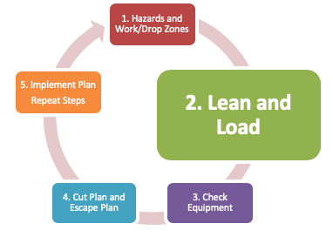
Step 2. Lean and Load
Storm damage can put limbs, branches, and trunks under great pressure
Power and communication lines
Tree trunk and root plate
Smaller branches may be pinched, creating spring poles
Potential energy may be released suddenly, explosively, and fatally!
Notes:
#15 Lean and Load
The lean and load of the tree caused by storm damage can put limbs, branches and trunks under great pressure. Trees resting on power and communication lines are under pressure and their weight stores energy in the stretched wires.
Tree trunks may be twisted and under pressure. Sometimes the tree is blown over and the root plate is ripped out of the ground. The trunk may roll and twist when freed due to pressure caused by the root plate.
The potential energy caused by lean and load may be released suddenly, explosively, and with unintended and potentially deadly consequences.

Slide 16
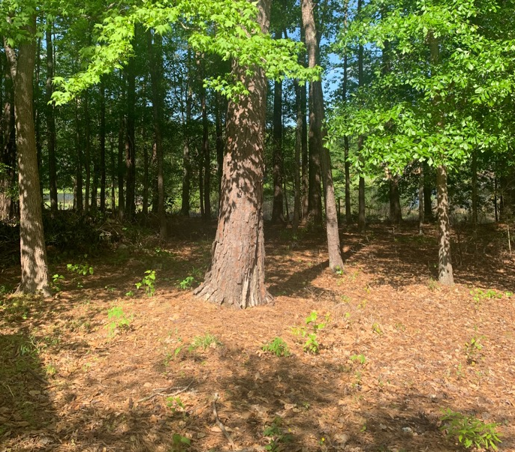
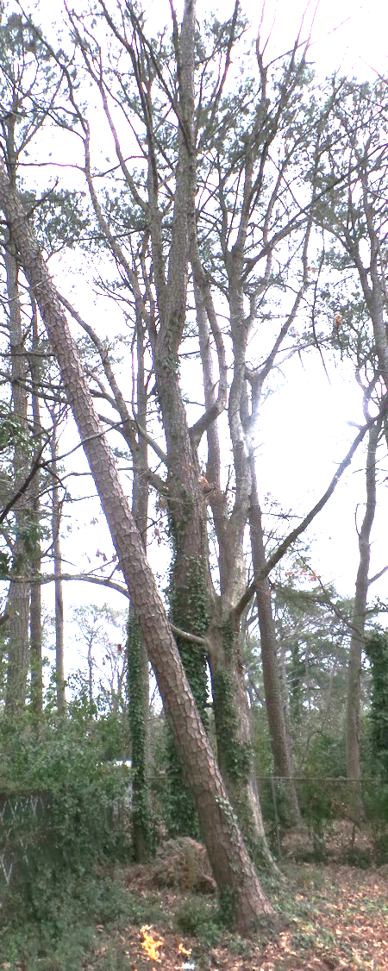
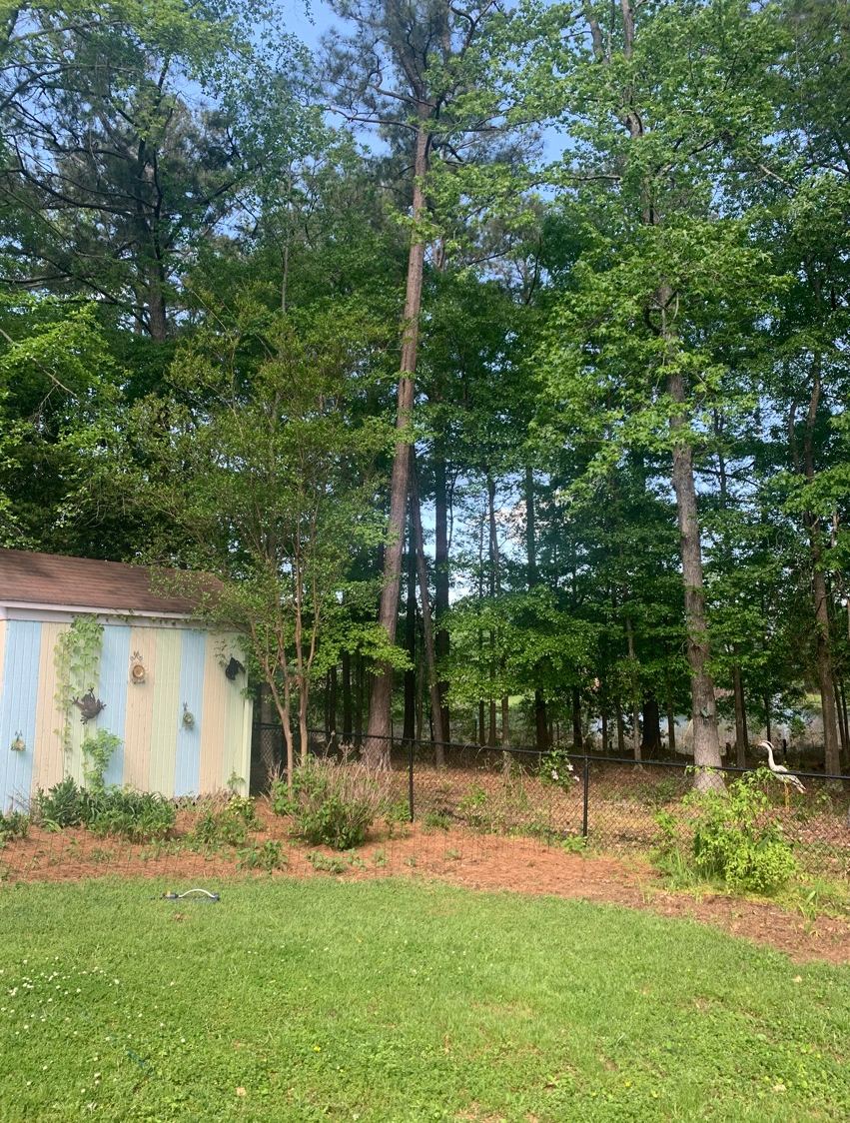
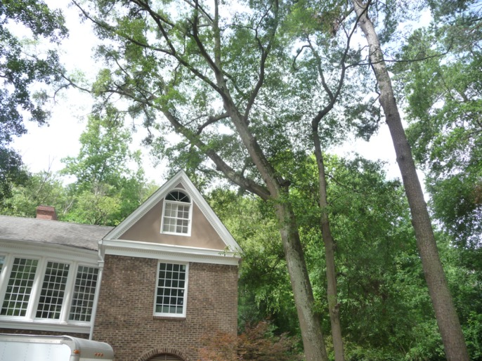
Notes:
16 Leaning Trees
Storms are among the many things that can cause trees to lean. Generally if the tree has 3 ft. or less of side lean, the notch may be adjusted to compensate. Wedges can also be helpful. A rope can be invaluable.

Slide 17
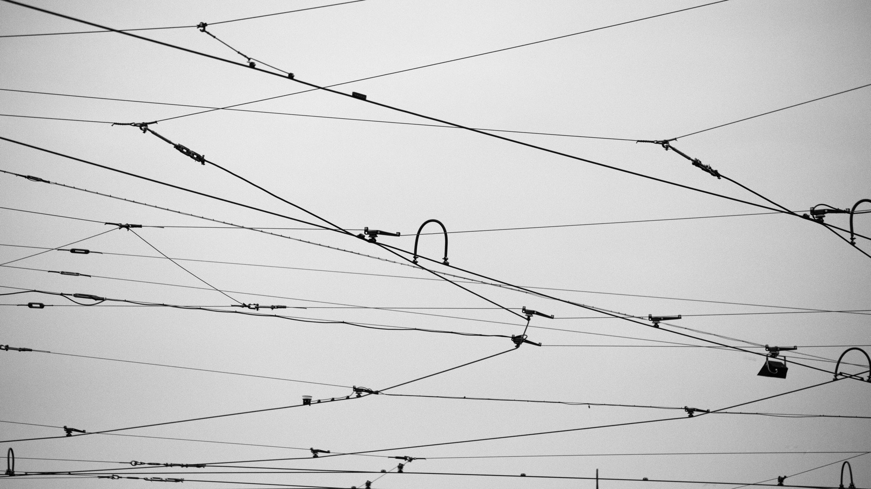

Wires
Notes:
#17 Wires -Load and Lean
When the load is released from power or communication lines, the tree may be tossed into the air.
Photo by Simona Sroková on Unsplash

Slide 18
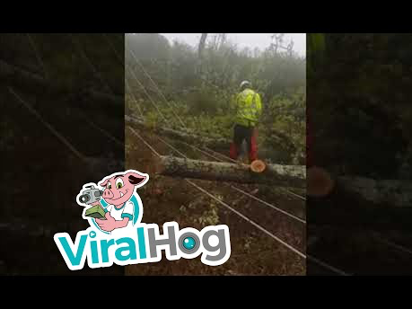
Notes:
#18
Show video:
https://www.youtube.com/watch?time_continue=19&v=dV86LCaVQLI

Slide 19
Wires
Notes:
#19 Wires -Load and Lean
It may be difficult to predict the exact form of the energy release. This is yet another example of what stored energy can do. It is also a very good example of why one should not hang out in the drop zone.

Slide 20
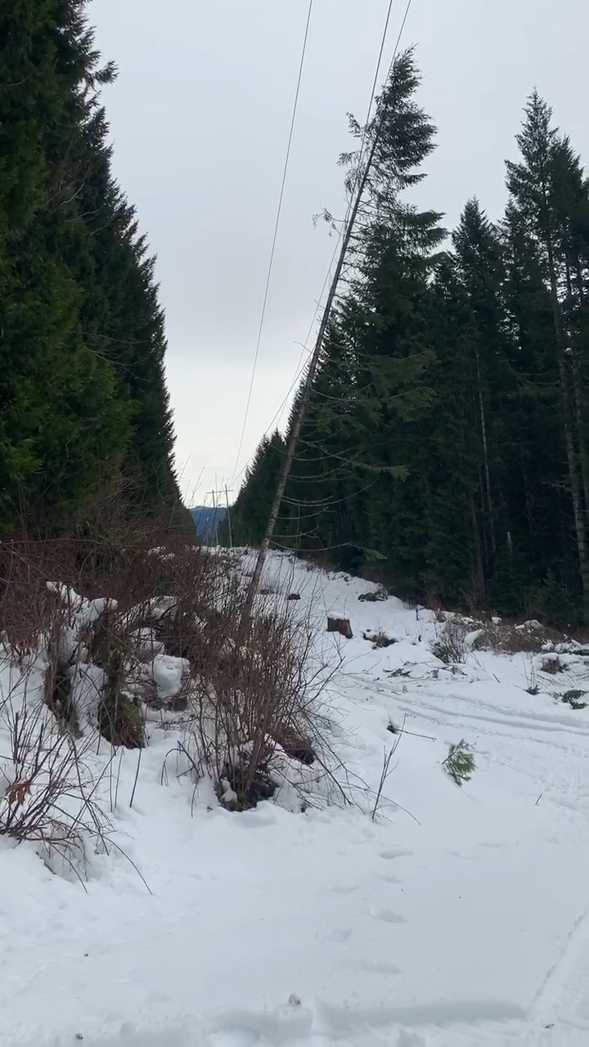
Notes:
#20 Wires - Lean and Load
Show video
Video provided by Phillip Kelley

Slide 21

Wires
Notes:
#21 Tie down
When a tree leans into powerlines, energy is stored in the lines that can toss the tree when it is cut free. That energy must be released slowly. Tie down the line and release it after the tree is removed.
Tie lines down in the same direction as the tree is pressing so that the energy can be released slowly after the tree is freed. Keep in mind, even a tied down line can move.

Slide 22
Compression and Tension Wood
Compression – pinch kickback
Tension – barber chair or spring pole
In general - Notch in compression wood, back cut in tension wood
Notes:
# 22 Compression and Tension Wood
Load and lean impacts compression and tension in wood. Wood under compression (with the fibers pushed together) will pinch the bar and can cause pinch kickback. If the bar is pinched on the top of the saw, the operator can be pushed back. If it is pinched on the bottom, the operator can be pulled forward.
Wood under tension (with stretched fibers) will open when cut. It can shatter and split with all the force released at once in a barber chair or spring pole.
In general, one can notch in compression wood and back cut in the tension wood.

Slide 23
Notes:
#23 Upright Tree
Generally, in an upright tree, the upper side of the tree branch is under tension and the lower side is under compression.
Point out compression and tension. Ask the class about branches not labeled.

Slide 24
Notes:
#24 Downed Tree
This may not be the case with storm damaged trees. The load on a downed tree is quite different. Compression and tension may not be the same.
Point out where it has switched. Note: the trunk was not under compression or tension and now it is.

Slide 25
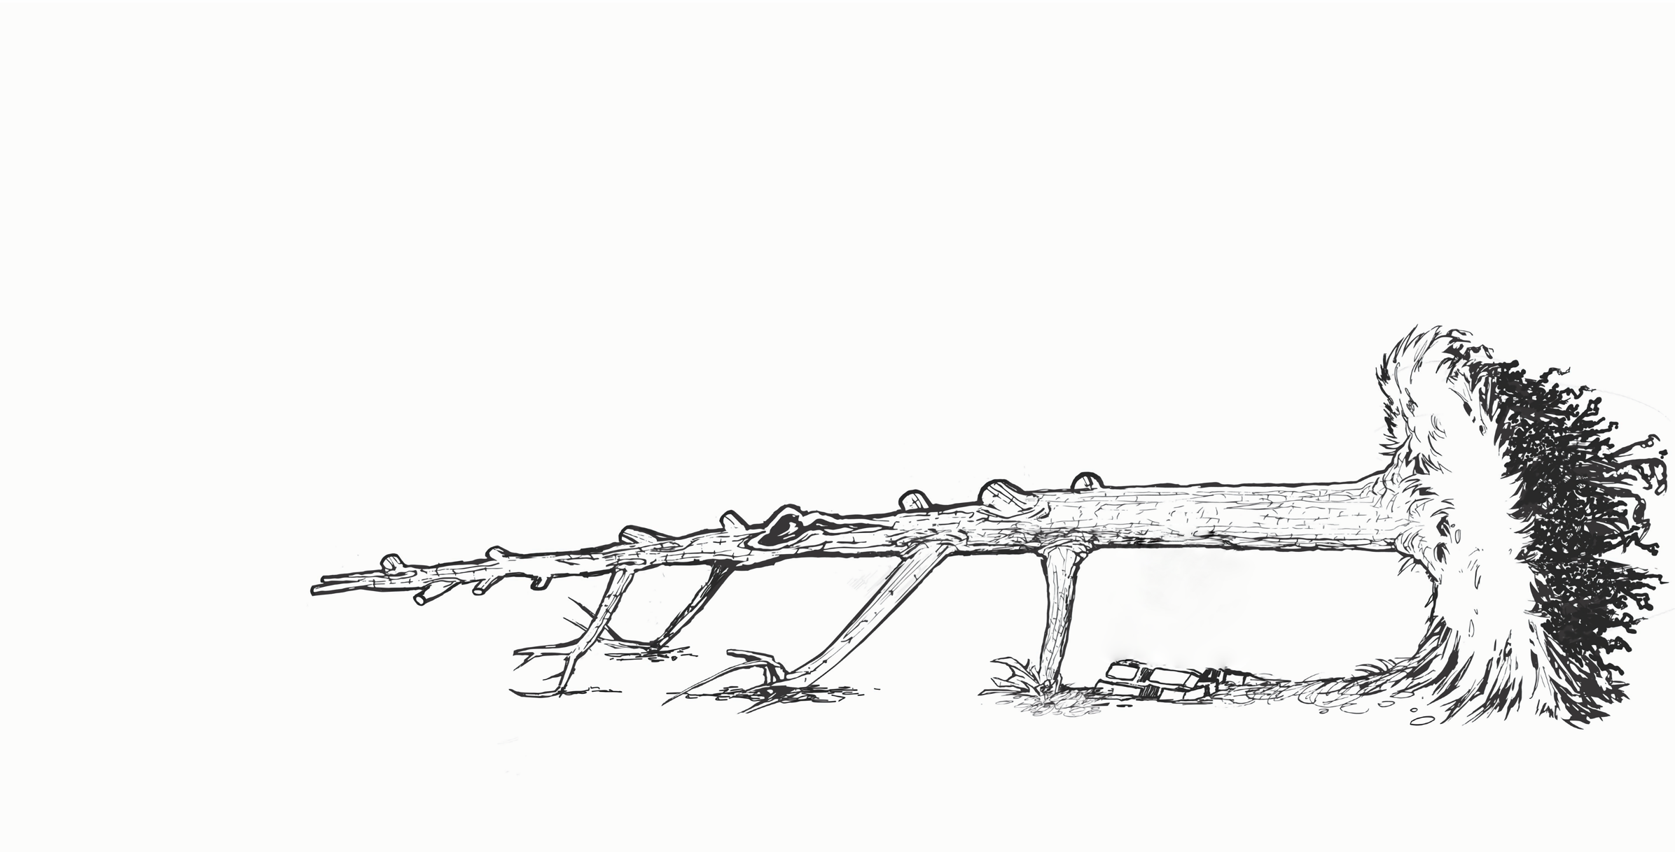
Notes:
#25 Tree on Ground
Even on the same piece of wood, tension and compression can vary. Both of these points are under tension. Every cut has the potential to change the compression and tension points as the tree moves and shifts.
Break the class into groups of three and hand out pictures of fallen trees. Ask them to identify wood under tension. Once they have identified it, have them report out to the class.

Slide 26
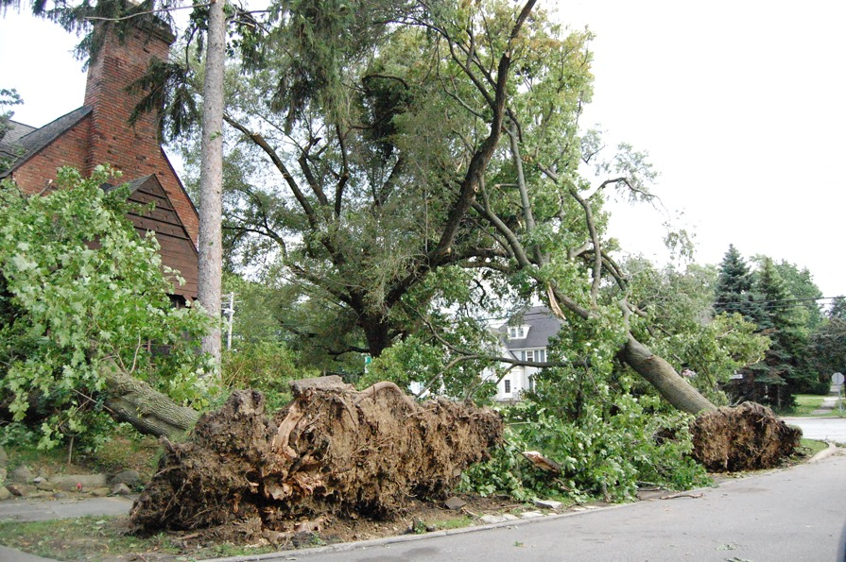
Uprooted Trees
Notes:
#26 Uprooted Trees
There are several potentially dangerous circumstances that can occur when the trunk is cut free from the remaining root mass.
The remaining root mass could fall forward and on top of the saw operator. The other potentially dangerous result is that the root mass and remaining trunk could whip upright and back into the ground after the bucking cut is made.
Trying to determine which of these two situations is likely to occur is difficult and only becomes easier after years of experience in working on these types of trees. For this reason, never stand on or straddle the trunk of an uprooted tree while making these cuts.
Fortunately, there are safe options for dealing with this.
Stu_spivack
https://www.flickr.com/photos/hz536n/

Slide 27
Pedestal and Root Plate
Notes:
#27 Root mass
When it appears the root mass and trunk will right itself after the bucking cuts are made, start the cuts at the top of the tree, working toward the butt, cutting the trunk into short sections. This incremental removal of trunk sections allows the root mass to counterbalance the tree gradually, standing upright slowly and safely. At this point, fell the remaining upright trunk section using normal felling methods

Slide 28
Pedestal and Root Plate
Notes:
#28 Root mass
To avoid the threat of the remaining root mass falling toward you, cut the trunk at a distance that is beyond the reach of the highest part of the root mass. Remove any branches that are in the way or that could potentially strike you after the tree is cut free from the stump. After being cut, the root mass will fall forward only until it is stopped by the remaining trunk section striking the ground.

Slide 29
Pedestal and Root Plate
Notes:
#29 Tension on bottom
If the tree appears to be under significant upward pressure from both ends, that is the trunk and root plate will likely fall forward, then make an open-face notch on the compression side of the tree followed by an undercut directly opposite the notch.

Slide 30
Pedestal and Root Plate
Notes:
#30 Tension on top
If it appears that the root mass will fall back in the hole, the cuts should be reversed, notch the bottom, back cut from the

Slide 31
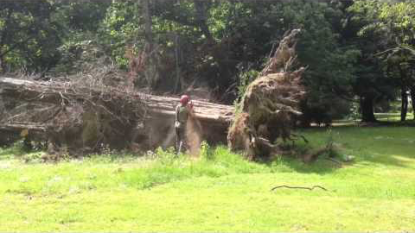
Pedestal and Root Plate
Notes:
#31 Video
https://youtu.be/j7lduKUT0-I
This operator has correctly guessed which way this root plate will move.

Slide 32
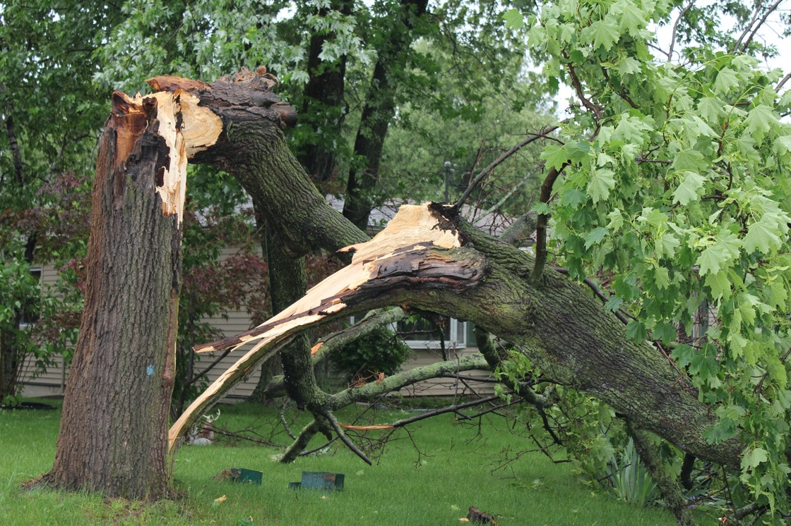
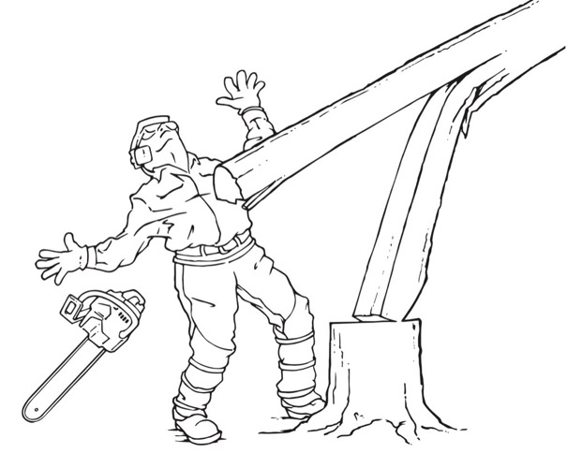
Broken and Attached
Notes:
#32 Broken and Attached
Another common type of storm damage includes trees that have broken off but still remain attached to the trunk. The upper portion may be hung up in another tree or resting on the ground. These situations are extremely hazardous as they are difficult to assess. Even when a felling plan has been carefully considered and executed, it may not be possible to determine the outcome.
The greatest risk of felling these trees is if the broken portion detaches unexpectedly. Barber chair (in which the tree splits at the base, kicking backwards and falling in an uncontrolled manner) may occur. In addition, the broken portion of the tree exerts pressure against the tree trunk. This can cause the tree to fall in the wrong direction when the release cuts are made.
Assess the tree and site carefully before making any cuts. Try to visualize how the broken top will respond to the release cuts that will be made. As these cuts are made, be prepared for the broken portion to detach at any time and be ready to retreat along the preplanned and cleared escape routes. Finally, avoid working under the hung up or hanging portion of the tree.
Photo credit:
LadyDragonFlyCC - >;<
https://www.flickr.com/photos/ladydragonflyherworld/

Slide 33
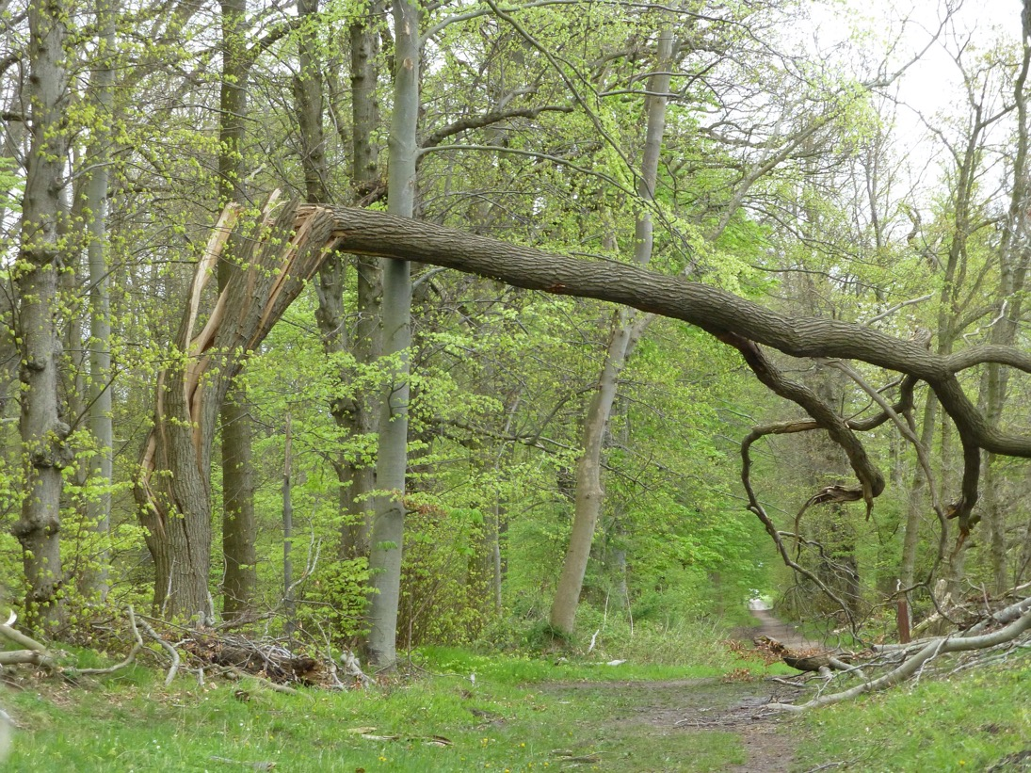
Broken and Attached
Climb?
Lift?
Cut?
Pull it down!
Notes:
#33 Broken and Attached.
This is another case of broken and attached. This is too dangerous to climb, and it would be difficult to get a lift into this area. In addition, the trunk is too dangerous to cut as is. It could possibly be bound and then cut. The failure is so great, it might be relatively easy to pull it down with mechanical advantage.

Slide 34
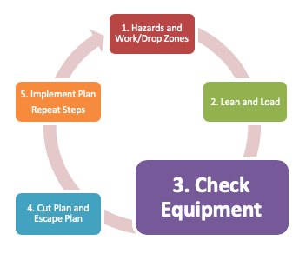
Step 3.
Check Equipment
Notes:
# 34 Check Equipment
And that brings us to the importance of checking the equipment. This is step three of the plan. If the equipment needed is not on sight, go get it before attempting to execute the plan.

Slide 35

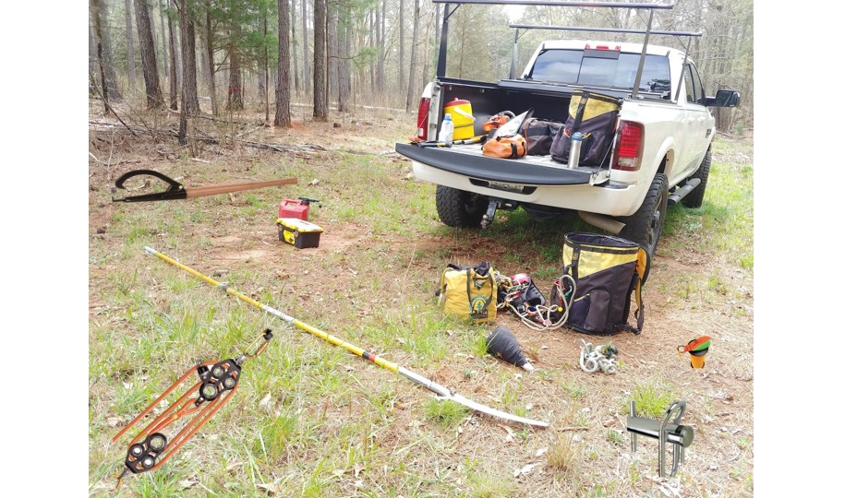
3. Check Equipment
Rope
Mechanical advantage
Cant hook
Wedges
Porta wrap
Pole saw
Throw line
Notes:
#35 Equipment
The more tools you have, the more you can do. Physical tools and mental tools. Are there any other “must-have” tools?
Ask, “What is missing?” First Aid Kit, come along...

Slide 36
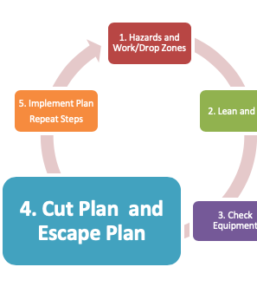
Step 4.
Cut Plan and Escape Plan
Notes:
#36 Step 4. Cut Plan and Escape Plan
At this stage in the five step plan, the operator has assessed the hazards presented by the tree and work site. He or she has given full consideration to the lean and load of the tree and has the equipment and expertise needed to tackle the tree. It is time to make the cut plan and escape plan.

Slide 37
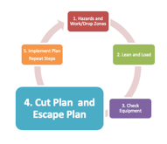
Some handy cuts:
  Bore Cut
  Mismatch
  Controlled Knee notch
Notes:
# 37 Cuts
First, we will talk about the cut plan. There are three cuts are that are relatively simple to execute and yet can handle many situations presented by storm damaged trees. These are the bore, mismatch, and controlled knee cut. A well-executed bore cut will allow the operator to move away from the tree as it falls. The mismatch and knee notch cuts can be released when the operator is at a safe distance using rope. These can be very handy when it is unclear how the tree will move or there is not safe escape route. Distance release techniques will keep the operator out of the drop zone.

Slide 38
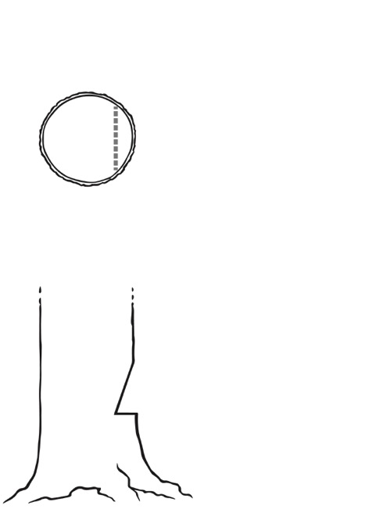
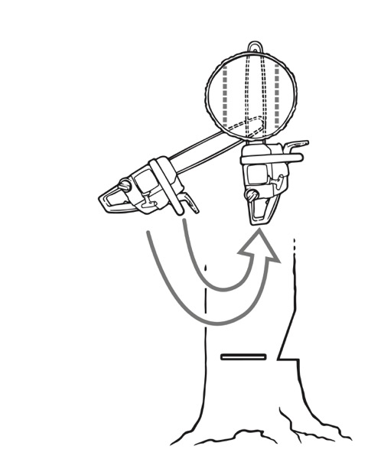
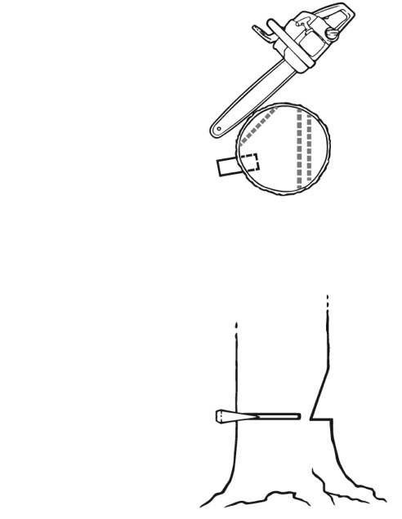
Bore cut
Notch should be 80% of the
Tree diameter
20 in.
18in.
Back strap
Hinge
Notes:
#38 Why use a bore cut?
On trees with forward lean, the traditional “race to the hinge” backcut can result in an explosive “barber chair,” in which the tree splits at the base, kicking backwards and falling in an uncontrolled manner. On trees leaning backwards or in other undesirable directions, a bore cut allows you to use wedges to control the direction of its fall. This cut allows also allows the operator to work from the inside out cutting out the tension that may be in wood under pressure.
The notch should be 80% of the tree’s diameter.
If the tree is 24” in diameter or less, the hinge will be 10% of the remaining material after the notch is removed. The hinge should be the same width across the entire diameter of the tree. If the tree is more than 24” in diameter, the hinge will be 5% of the remaining material after the notch is removed.

Slide 39
Bore Cut
Notes:
#39 Bore Cut
You can see the appropriate size of the notch cut here. As the saw operator starts the bore cut, he is using the attack portion of the bar. The attack portion is the top half of the tip of the bar. He literally steps around to use the full width of the bar. Because the saw is contained in the tree, there is no kickback.
The small backstrap holding the tree together can be cut with a pole saw at a safe distance if you suspect the tree will move or there is no safe escape route. It is important to practice this cut before using it.

Slide 40
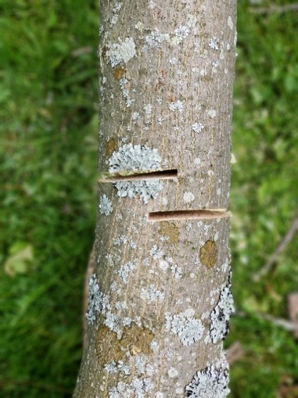
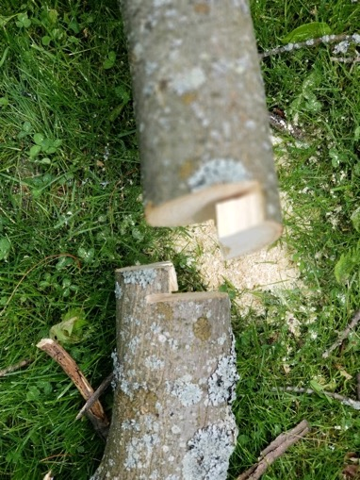
Mismatch Cut
Notes:
#40 Mismatch Cut
The mismatch cut (or bypass cut) is similar to the technique used when snapping off wood aloft in “cut and chuck” operations, with one major exception. Operators should not attempt to snap off the hazard or danger tree by hand. Rather, use a pull rope or push stick to free the branch or trunk. This allows the operator to be well away when the release occurs. This is much safer.
Attach the pull line before cutting. The lowest cut should be made on the pull line side. It is easier to snap off the cut if it is pulled (or pushed) in the direction of the side with the lowest cut.
The mismatched cuts are made from opposite sides of the tree, much like on a horizontal branch when aloft. This avoids the tension and compression fibers, (typically, but not always on the top and bottom of the tree) as much as possible.
The amount of overlap or bypass, along with the distance between the cuts, will vary with diameter and wood strength. The further the cuts are apart, the more holding power.

Slide 41
Controlled Knee Cut
2. Bore
1. Notch
1. Notch
3. Mismatch back cut
2. Bore
3. Mismatch back cut
Notes:
#41 Controlled Knee Cut
The controlled knee cut is excellent for dealing with trees suspended on overhead obstacles, whether it be wires, other trees, or houses.
The notch is made and the hinge is setup with a bore cut. In a standard felling operation with an upright tree, the holding strap would be severed at level or below the hinge, but in a hazard/danger situation, this would require staying close to the tree, a location to be avoided.
Instead, a mismatched back cut is made beneath the level of the hinge. Wood strength and diameter will once again affect the distance between the two cuts. In general, the further below the bore cut, the greater the amount of force that will be required to release the cut.

Slide 42
Controlled Knee Cut
Notes:
#42 More Controlled Knee
The knee cut can be used to release hung or snagged trees. It also allows for a safe distance release. This cut makes smart use of notches.
The tree must be large enough in diameter so that a bore cut can be made to create the hinge. Attach the pull line first to the tree and use any mechanical advantage needed to pull the tree. Then make an open-faced notch and set up the hinge with a bore cut. There will be a small piece of wood, called the strap, uncut at the back of the bore. Place a mismatch cut just below the bore, bypassing the two kerfs. This will hold until the pull line is loaded. The tree will fold and likely dislodge the snag. If it doesn’t dislodge the tree, move the line up and do it again. The tree will become more horizontal with each cut, walking away from the snag.

Slide 43

Escape Plan
Felling Direction
90-5-15 Rule
Distance release – safe option
Best escape route might not be easily identified
The escape route will change
Safe
Safe
Notes:
#43 Escape Route
It is critical to get away from moving trees once they are cut. 90% of all fatalities occur within 5 ft. of the trunk within 15 seconds of tree movement.
Most of you are familiar with this figure that highlights the safest escape routes when felling a tree. Because of pressure on storm damaged trees, the best escape route might not be easily identified. It can be difficult to determine which way trees will move.
Furthermore, as the operators works the tree, the escape route will change. Everyone ALWAYS need a safe, clear escape route, regardless of the operation preformed.
The reality is that while cutting from a “distance” won’t always be possible, it is the safer option and should be considered.

Slide 44
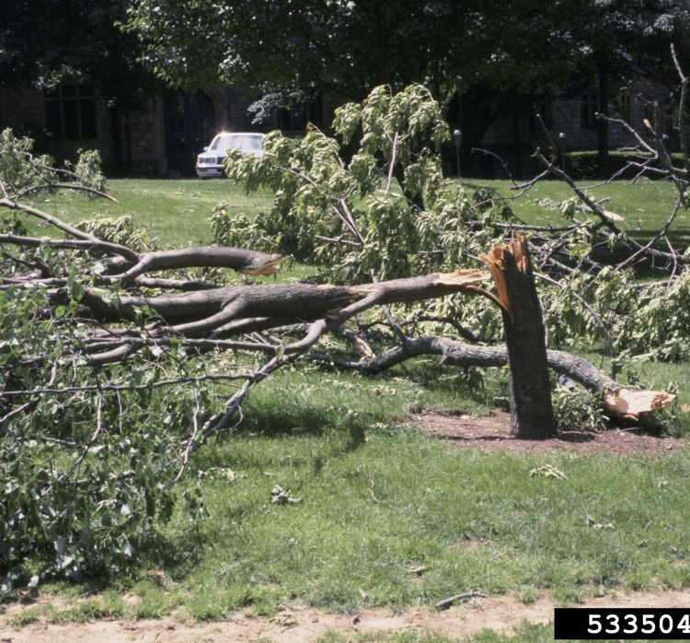
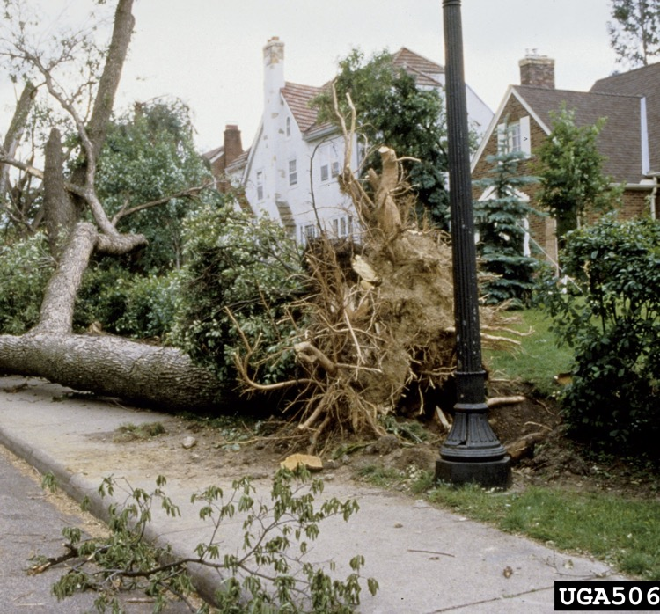
Escape Plan
Joseph O’Brien, USDA Forest Service, Bugwood.org
Mary Ann Hansend, VPI & State University, Bugwood.org
Notes:
#44 Remove Tripping Hazards
Clear out small debris before beginning work on a tree. This will help the operator get a better look at the tree and reduce tripping hazards. Continue removing debris throughout the operation. This is the best way to avoid tripping hazards.

Slide 45
5. Implement Plan and Repeat Steps
1. Hazards and Work/Drop Zone
2. Lean and Load
3. Check Equipment
4. Cut Plan /Notch Plan/Escape Plan
5. Implement Plan
Repeat Steps
Load and lean change with each cut
Drop zone may shift
Different equipment may be needed
Another cut plan and escape plan needed
Notes:
#45 Implement and Repeat Steps
Every time a cut is made, the operator must run through the 5 steps of the cutting plan. It is also critical to share the plan with your team as hazards dictate.

Slide 46
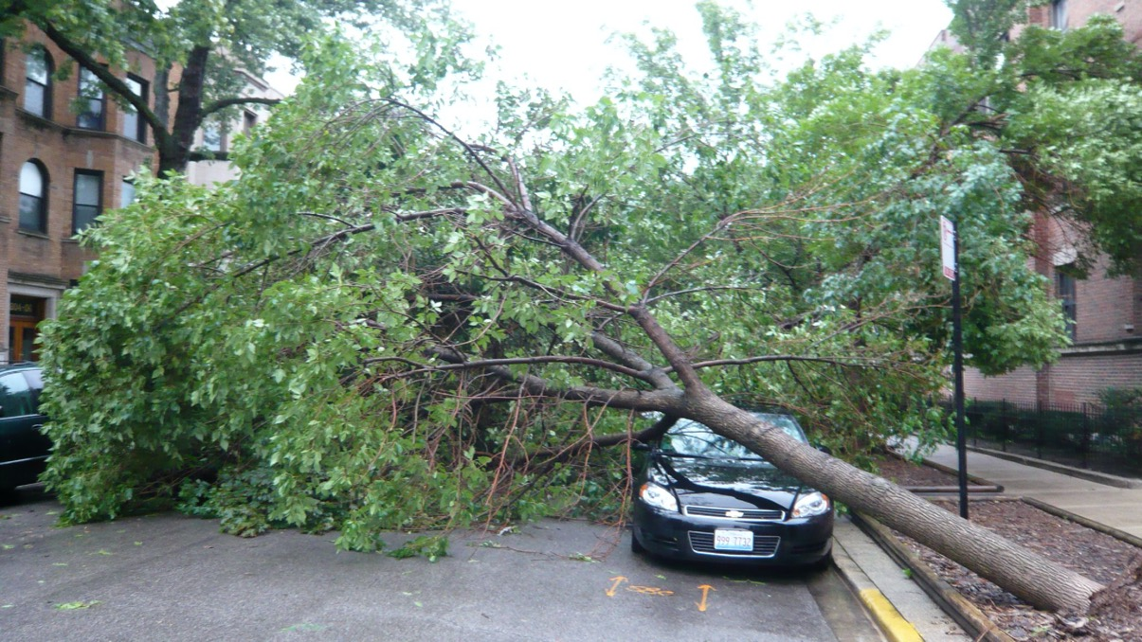
Tips to Get Started
Tips to Get Started
Keep your saw below your shoulders
Clear off the foliage
Remove tripping hazards
Notes:
#46 Tips to Get Started
Take all the time needed to assess the situation. Keep the saw below the shoulders. If kickback occurs above the shoulders, the saw can easily hit the head. Never use a ladder with a chainsaw.
Clear off the foliage and remove any tripping hazards.
After the foliage has been removed, you may see hazards you had not seen before and any load and lean will become clearer.

Slide 47
Tips to Get Started
Next:
Work from the top down if possible
Take the weight off the tree
Remove non-load bearing branches
1. Hazards and Work/Drop Zone
2. Lean and Load
3. Check Equipment
4. Cut Plan /Notch Plan/Escape Plan
5. Implement Plan
Repeat Steps
Notes:
#47 Tips to Get Started
Read the slide.
You can kick or shake them to them to determine if the branches are bearing weight.

Slide 48
Tips to Get Started
Tip to Get Started
Systematically whittle the project down:
Tackle a pressure point
Do the easiest first
1. Hazards and Work/Drop Zone
2. Lean and Load
3. Check Equipment
4. Cut Plan /Notch Plan/Escape Plan
5. Implement Plan
Repeat Steps
Notes:
# 48 Tips to Get Started
Read the slide.
Implement the five step plan with each cut. The tree will shift and more as you proceed. You will need to reconsider the hazards, lean and load, equipment and escape plan with each cut.

Slide 49
Know Your Knots and Rope Work
Bowline
A version of the Valdotain Tresse (VT)
Prusik
End knots (clove hitch and cow hitch)
Fiddle blocks and how to use them
Come alongs
Notes:
#49 Knots and Rope work.
There are many great resources for use available online that will help with these knots. Remember, the more you know, the safer you can be. You will need to be very resourceful to handle storm damaged trees safely.
Hand out rope and ask the students to tie a bowline, VT, clove hitch and cow hitch. Show them a mechanical advantage kit.

Slide 50
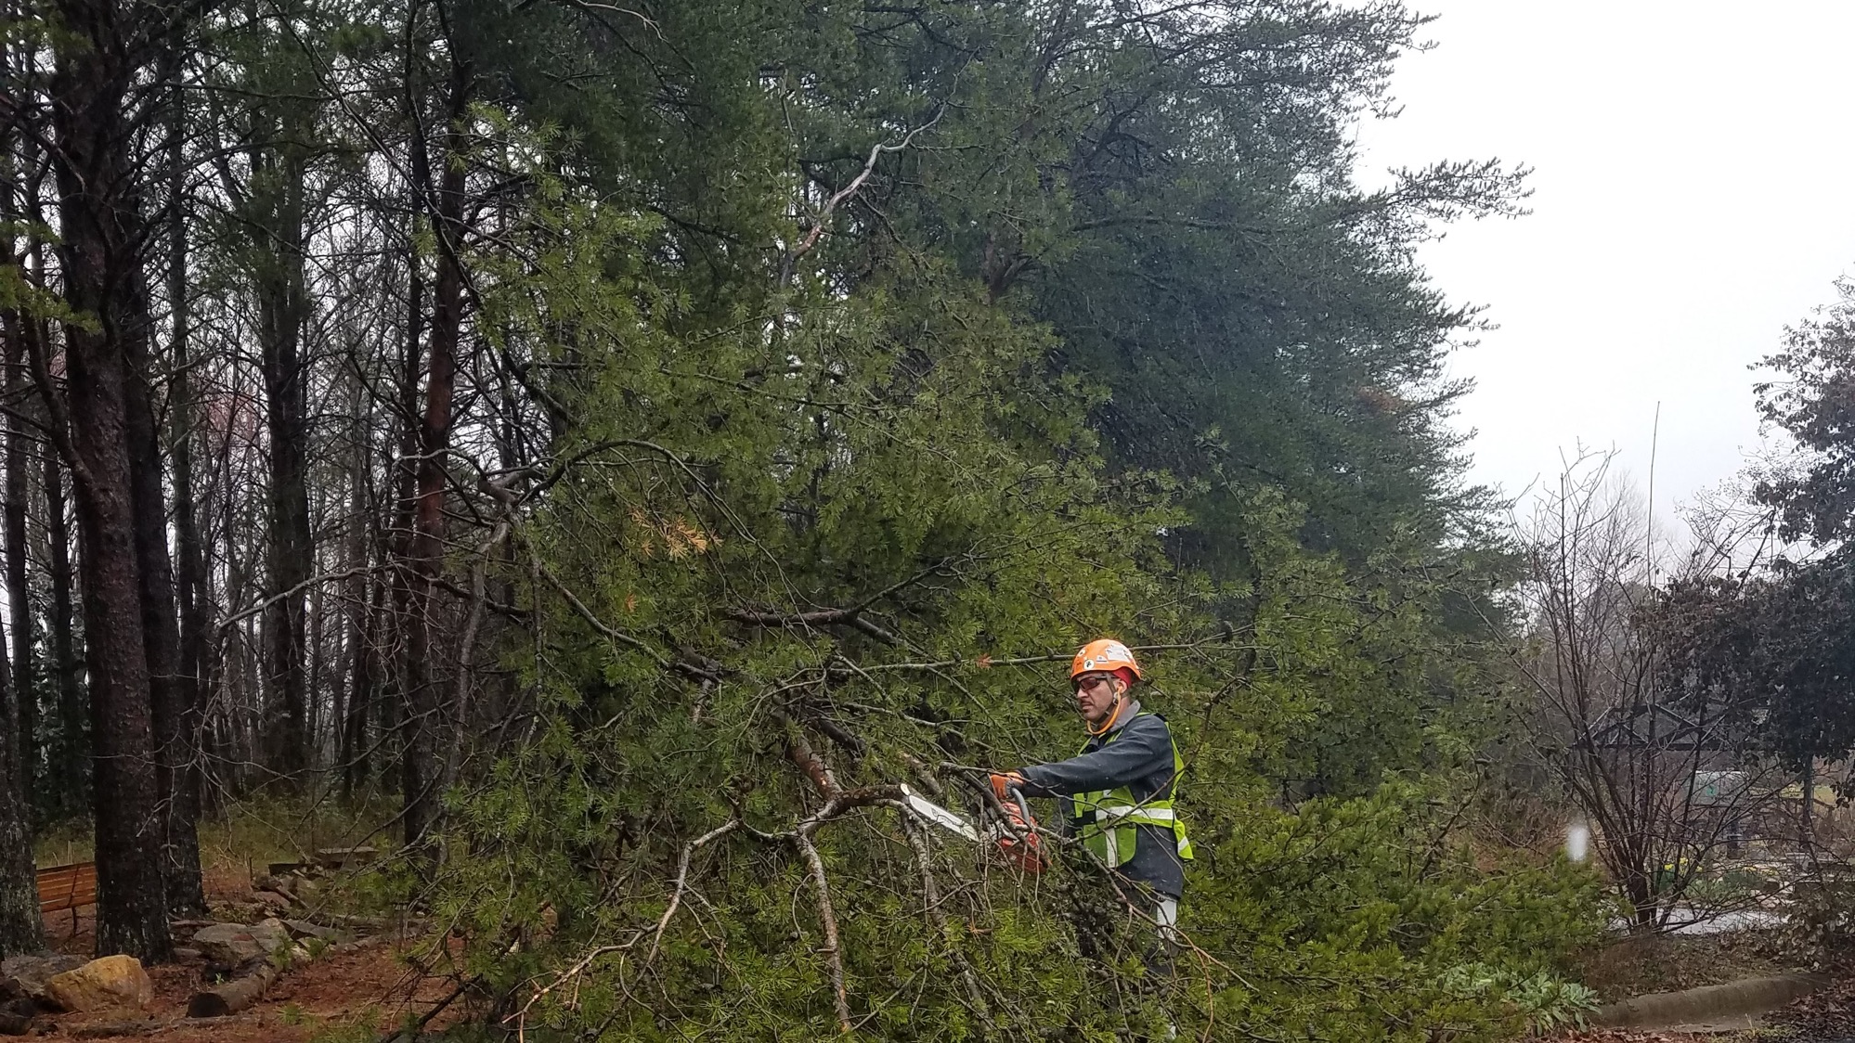
How many people should be cutting?
One!
The tree will shift as load and lean changes
Extra people can be spotters
The more eyes, the better
Notes:
#51 How many people should be cutting?
One.
Read the slide.

Slide 51
Command-and-Response Communication
“A method of verbal, audible, or visual communication shall be discussed and established during the job briefing prior to the start of removal or rigging operations.” –ANSI Z133-2017
Notes:
#51 Communication is critical.
The use of command-and-response communication to assure that important information is both sent and received. If you see something say something! Never assume everyone saw it. Assumptions can be very dangerous.

Slide 52
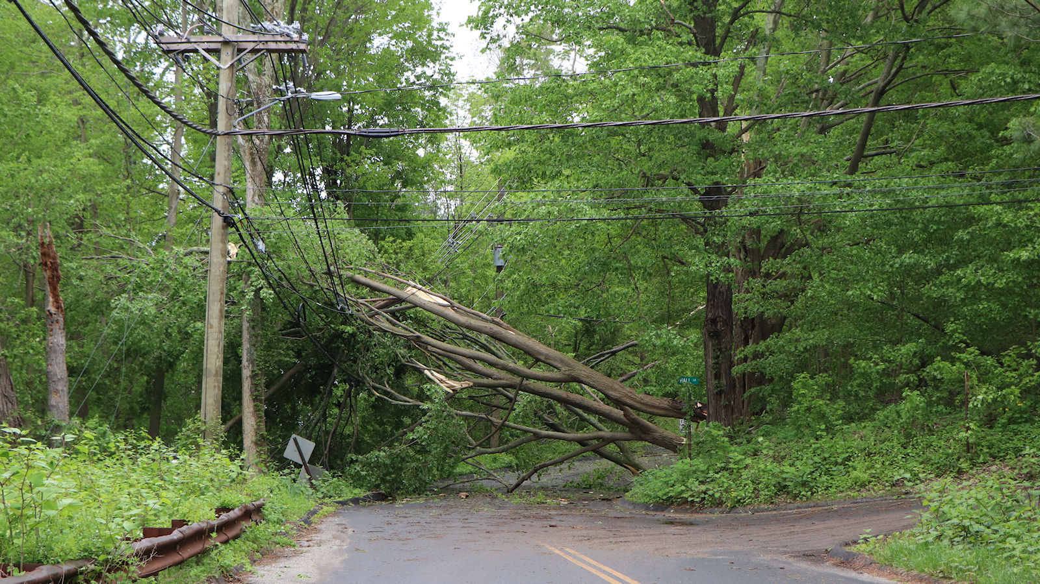
Notes:
#52 This is a hot mess!
The hazards are many and there are multiple sources of lean and load.
Energized wires
Energy in wire
All over head
Traffic issues
Broken and attached
Could be root plate issues
Large work site
Ask, “Do I have the equipment and skills to handle this?”
This is not a two-person job. Do you have the experience and equipment? If not, get help.

Slide 53
Do not proceed in the face of uncertainty!
    Do not assume anything!
    Do not rationalize away an anomaly
    Do not be embarrassed to ask for help
    Do not believe nothing bad can happen
    Do not think the task is “simple” or “routine”
Notes:
#53 Do not proceed in the face of uncertainty.
When doubt exists, stop activity.
Place system/equipment/component and job site in a safe condition and get help.
Inform your immediate supervisor of the problem. Perform another tailgate if work conditions are different than what you thought. Speed and haste can kill you.

Slide 54
Final Comments:
Don’t cut trees or wood alone!
Look for and take advantage of training opportunities!
Notes:
#54 Final Comments
Read this slide.

Slide 55
Questions?
Notes:
#55 Any Questions?
Question?

Slide 56

The permalink for this UGA Extension publication is extension.uga.edu/publications/detail.html?number=C1199
Circular 1199 Reviewed May 2023
Published by the University of Georgia in cooperation with Fort Valley State University, the U.S. Department of Agriculture, and counties of the state. For more information, contact your local UGA Cooperative Extension office. The University of Georgia College of Agricultural and Environmental Sciences (working cooperatively with Fort Valley State University, the U.S. Department of Agriculture, and the counties of Georgia) offers its educational programs, assistance, and materials to all people without regard to race, color, religion, sex, national origin, disability, gender identity, sexual orientation or protected veteran status and is an Equal Opportunity, Affirmative Action organization.

